Slide 2
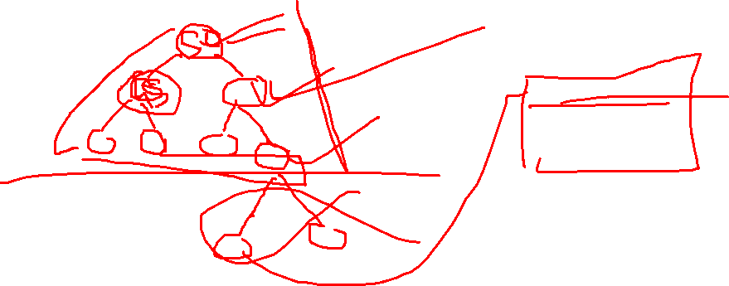
The B+-tree index structure is the most widely used of several index structures that maintain their efficiency despite insertion and deletion of data.
A B+-tree index takes the form of a balanced tree in which every path from the root of the tree to a leaf of the tree is of the same length.

Slide 3
What is B+tree
The B+ tree is a balanced binary search tree. It follows a multi-level index format.
In the B+ tree, leaf nodes denote actual data pointers. B+ tree ensures that all leaf nodes remain at the same height.
In the B+ tree, the leaf nodes are linked using a link list. Therefore, a B+ tree can support random access as well as sequential access.
In the B+ tree, every leaf node is at equal distance from the root node. The B+ tree is of the order n where n is fixed for every B+ tree.
It contains an internal node and leaf node

Slide 4
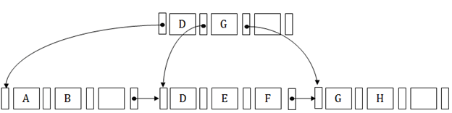

Simple B+tree

Slide 5
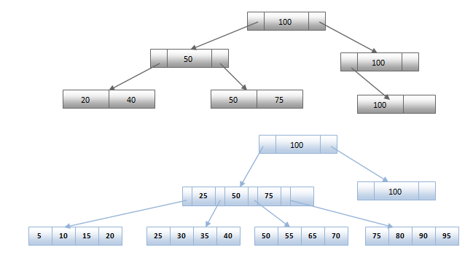
With n =3

Slide 6
B+ tree
Leaves are used to store data records.
It stored in the internal nodes of the Tree.
If a target key value is less than the internal node, then the point just to its left side is followed.
If a target key value is greater than or equal to the internal node, then the point just to its right side is followed.

Slide 7
B⁺-Tree Index Files (Cont.) properties/structure
B⁺-tree is a rooted tree satisfying the following properties:
All paths from root to leaf are of the same length
Each node that is not a root or a leaf has between [n/2] to n children.
A leaf node has between [(n–1)/2] and n–1 values
If n = 4 then
Min keys in leaf node is (n-1)/2 = 3/2 = 1
Max key in leaf node is (n-1) = 3
Internal node has maximum n/2 to n children that is 2 to 4 childern

Slide 8
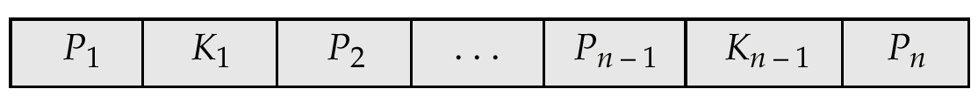

B⁺-Tree Node Structure
Typical node
K_{i} are the search-key values
P_{i} are pointers to children (for non-leaf nodes) or pointers to records or buckets of records (for leaf nodes).
The search-keys in a node are ordered
K₁ < K₂ < K₃ < . . . < K_{n–1}
(key are in sorted order)

Slide 9
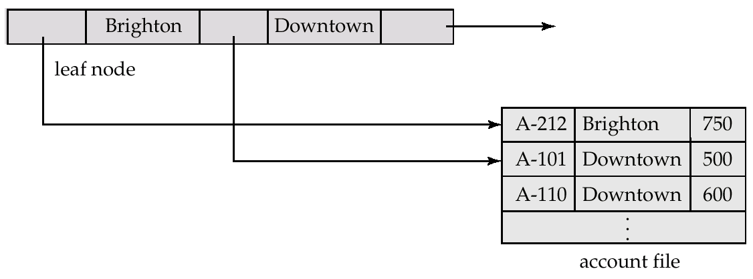
Leaf Nodes in B⁺-Trees
Properties of a leaf node:
I L_{j} are leaf nodes and i < j, L_{i}’s search-key values are less than L_{j}’s search-key values
P_{n} points to next leaf node in search-key order

Slide 10
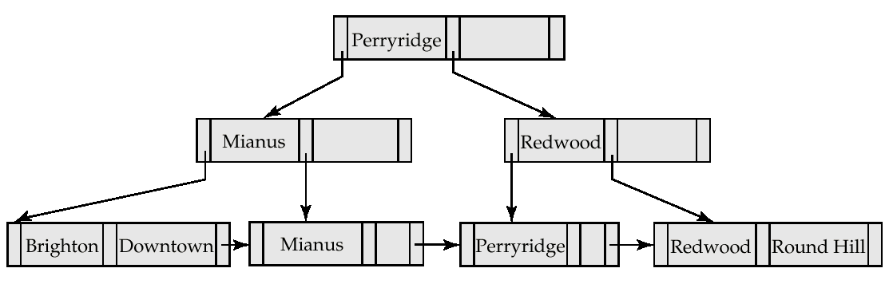
Example of a B⁺-tree
root
Internal node
Leaf node
B⁺-tree for account file (n = 3)

Slide 11
e.G for explanation
Construct the B+ tree for given key
1,4,7,10,17,21,31,25 order is 4
Order(m) =4
Max children = 4
Min children = m/2 =2
Max keys = m -1 =3
Min keys = [m/2] -1 =1

Slide 12


Slide 13
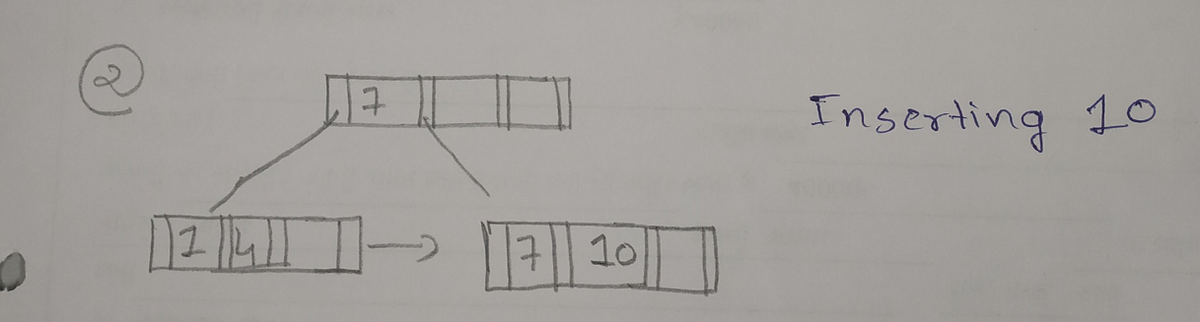
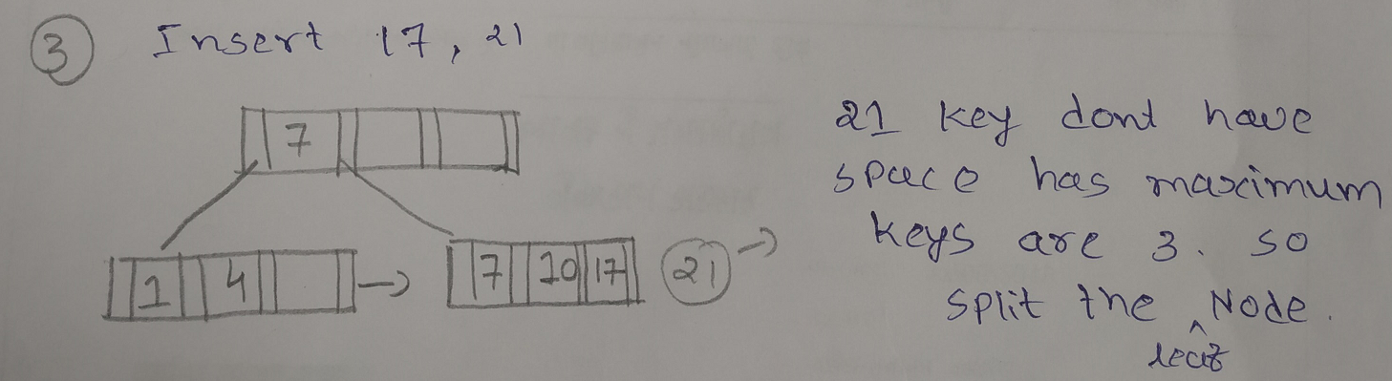

Slide 14
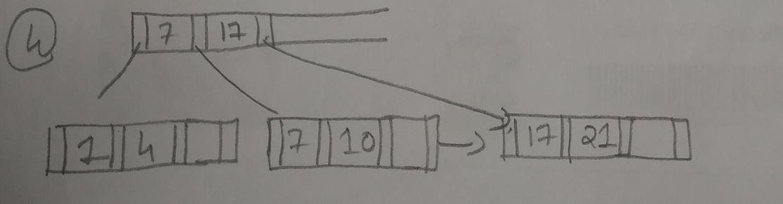
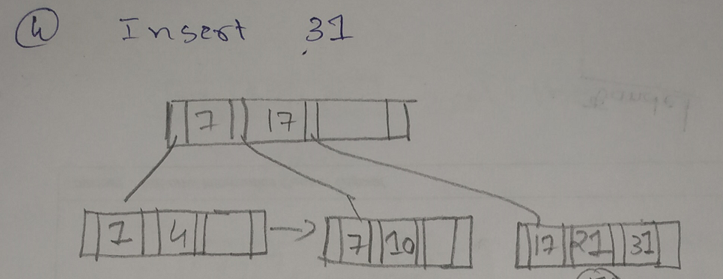

Slide 15
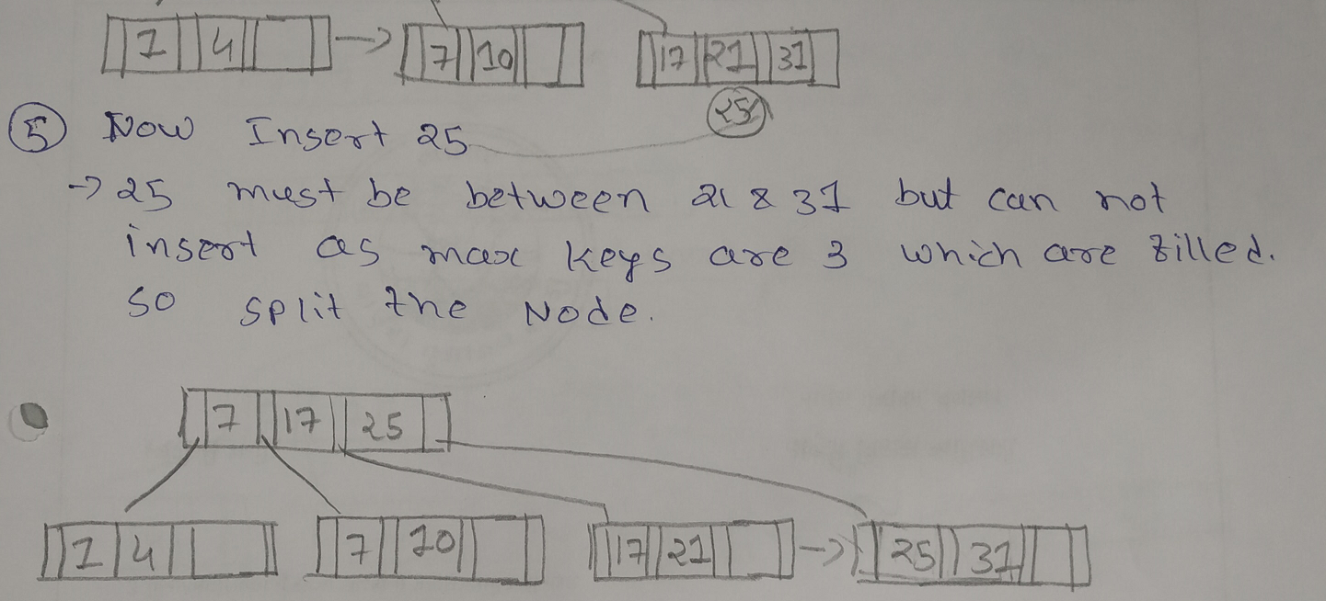

Slide 16
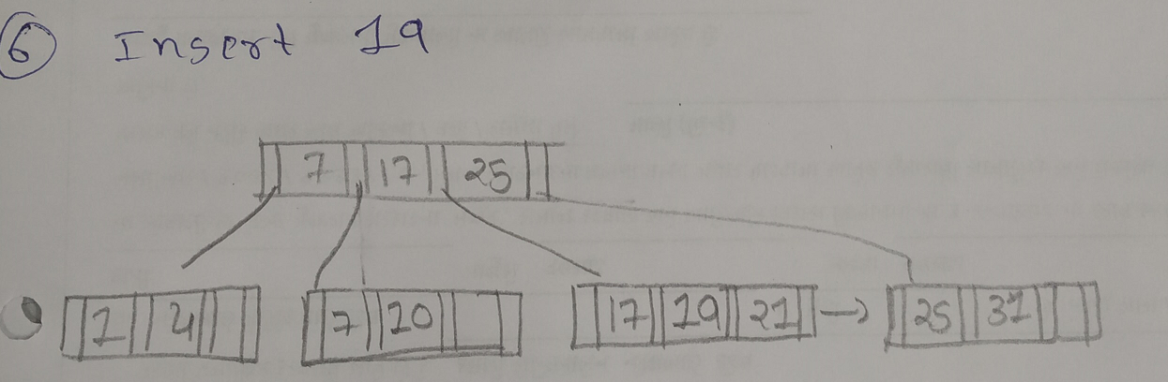
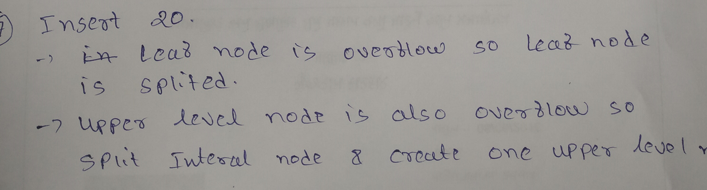

Slide 17

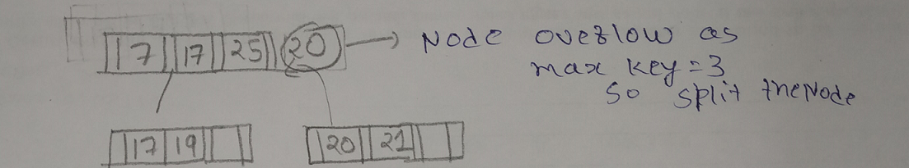
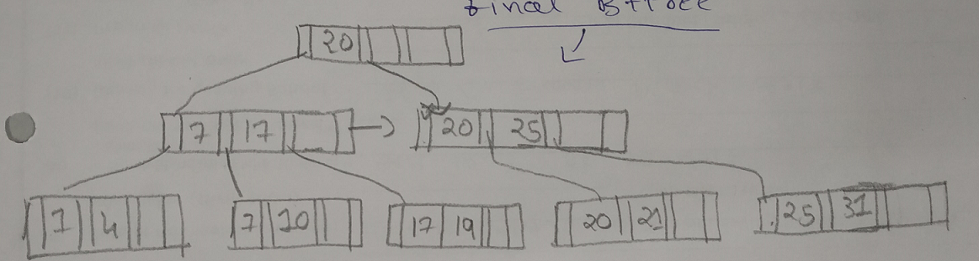
Final tree

